Slide 1



EDM Project Presentation
-Reflection on projects
Hitesh Vijan
Diego Acosta
Prabhjot Chawla

Slide 2

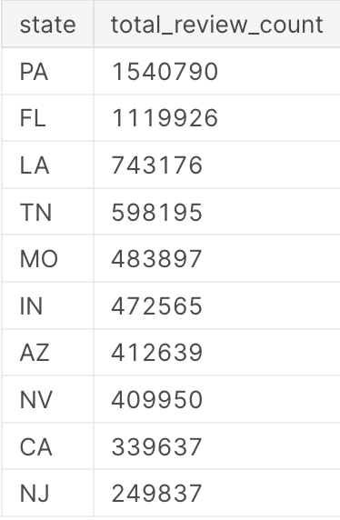
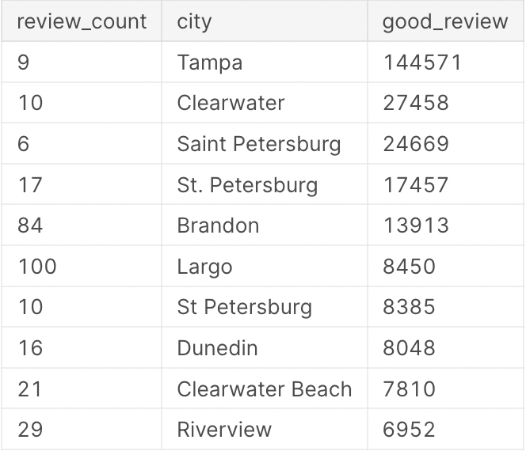
Mini Project 1
Intent: Identify the top ten states with the highest number of overall reviews in the Yelp dataset to inform decisions related to business location.
Output: A table with two columns: the state and the total number of reviews in that state, ordered by total review count in descending order. The output reveals that Florida and Pennsylvania have the most overall reviews.
Skills developed: Subqueries, aggregating data with functions like SUM(), sorting data with ORDER BY clause, exploratory data analysis, identifying key metrics for business decisions.
Intent: Identify the top ten cities in Florida with the most positive reviews in the Yelp dataset to inform business location and marketing strategies.
Output: A table with three columns: the review count for the business, the city, and the count of positive reviews in that city. The table is sorted in descending order based on the number of positive reviews.
Skills developed: Filtering data using the LIKE operator, joining tables, grouping data, analyzing data at the city level, and identifying key metrics for business decision-making.

Slide 3
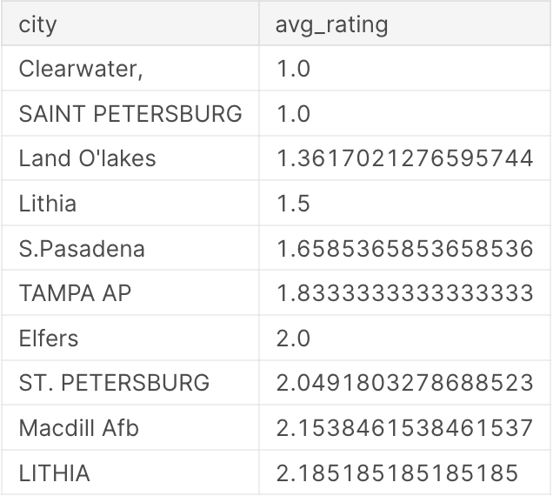
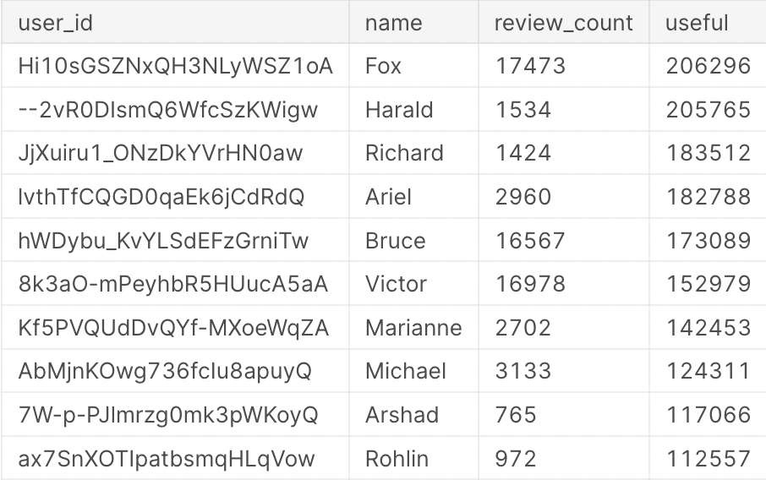
Mini Project 1
Intent: To identify the city with the lowest average rating in Florida, which can help inform business decisions related to location, competition, and customer expectations.
Output: A table with two columns: the city and the average rating. The table is sorted in ascending order based on the average rating.
Skills developed: Joining tables, aggregating data, filtering data, and sorting data based on a specific column. The query helps businesses understand customer sentiment and make informed decisions about location and competition.
Intent: To identify Yelp users who have the most influence by looking up individuals with the most usefulness in the User_Yelp table. This information can help businesses identify key opinion leaders and influencers on the platform, which can inform their marketing strategies and customer engagement tactics.
Output: A table with four columns: user_id, name, review_count, and useful. The table is sorted in descending order based on usefulness and review_count, and only includes users with a review count of 400 or more.
Skills developed: The query helps businesses identify key opinion leaders and influencers on Yelp to inform marketing and customer engagement strategies.

Slide 4
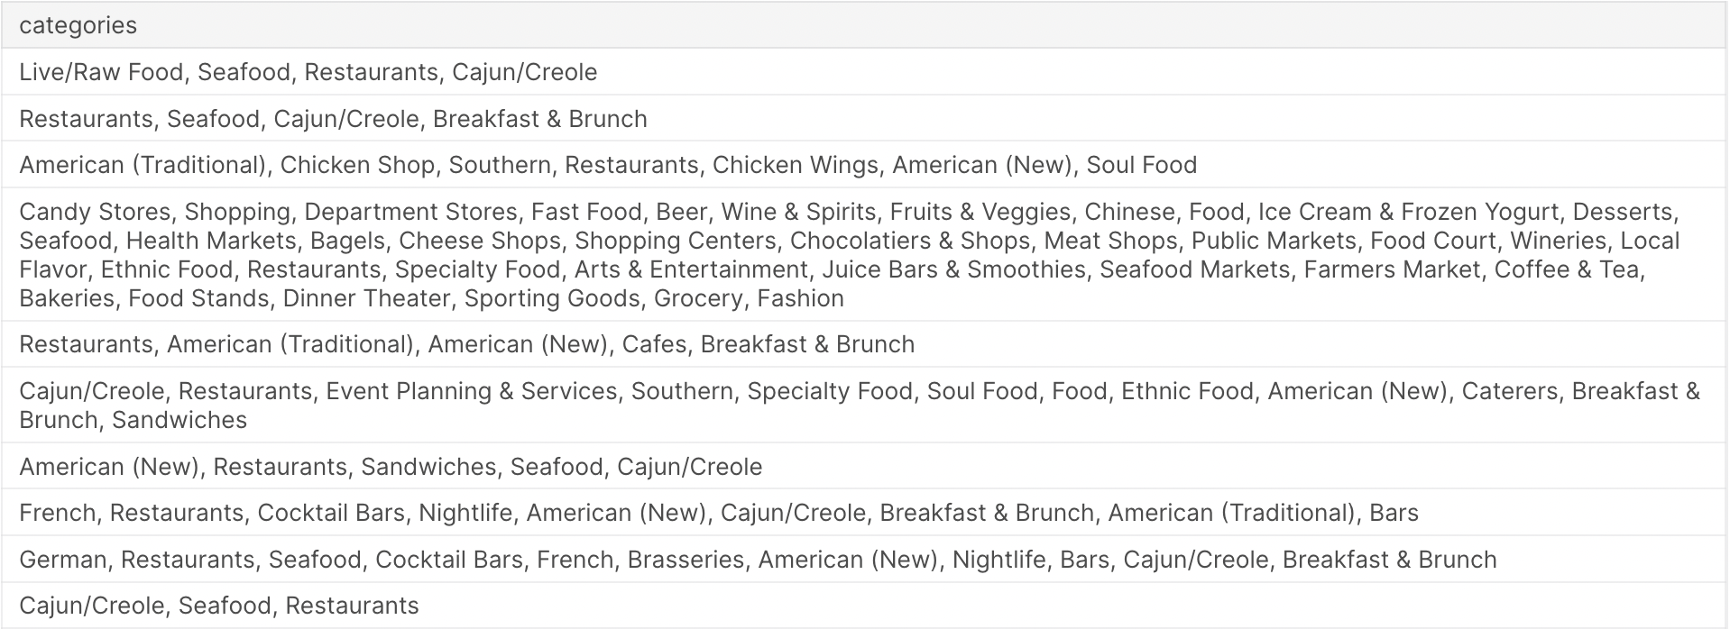
Mini Project 1
Intent: The intent of this query is to identify the most popular types of restaurants based on the number of reviews they have received, which can help in deciding what to sell at a new restaurant.
Output: This query outputs the top 10 categories of restaurants/food businesses with the most review counts.
Skills developed: SQL querying, data analysis, business decision making.

Slide 5

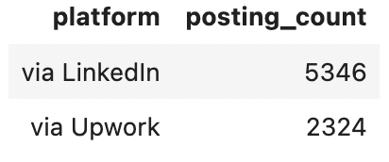
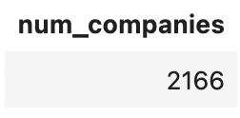
Mini Project 2
Intent: Identify the two most common platforms for companies to list job postings, based on the Job_Posting table in the database.
Output: A table with two columns: "platform" and "posting_count". The "platform" column contains the names of the two most common job posting platforms, and the "posting_count" column contains the number of job postings on each platform.
Insight: The output of this query will provide insight into which platforms are most commonly used by companies to post job openings, which could be useful for a company looking to advertise job openings.
Skills developed: SQL query writing, data analysis, data interpretation.
Intent: The intent of this query is to determine the number of companies that allow Work From Home.
Output: The output of this query is a single value that represents the number of companies that allow Work From Home.
Business relevance: This query is useful for gaining insights into the job market trends in terms of remote work. It can help businesses understand the prevalence of remote work and make informed decisions about offering remote work options to their employees.
Skills developed: SQL syntax, data analysis, data interpretation.

Slide 6
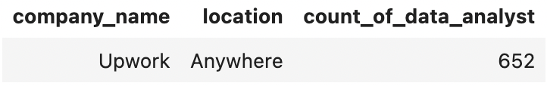
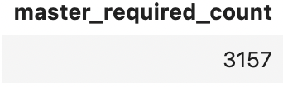
Mini Project 2
Intent: This query aims to find out which company has the highest number of job postings for Data Analyst roles and display their company name and location.
Output: The query outputs a single row containing the name and location of the company with the highest number of job postings for Data Analyst roles.
Business relevance: This query is useful for job seekers who are interested in Data Analyst positions. By knowing which companies have the most job postings for this role, job seekers can focus their job search on those companies. It is also useful for companies to know which companies are posting the most Data Analyst job openings.
Key skills developed: SQL syntax, data analysis, data interpretation.
Intent: Find the count of job postings that require a Master's degree or higher.
Output: The query output the count of job postings that require a Master's degree or higher.
Narrative: In today's highly competitive job market, it is becoming increasingly important for individuals to have advanced degrees to stand out from other job applicants. To gain an understanding of the job market for highly skilled positions that require a Master's degree or higher, we can use this SQL query. By looking at the number of job postings that require advanced degrees, we can gauge the demand for highly educated individuals in the job market.
Skills developed: SQL, data analysis.

Slide 7
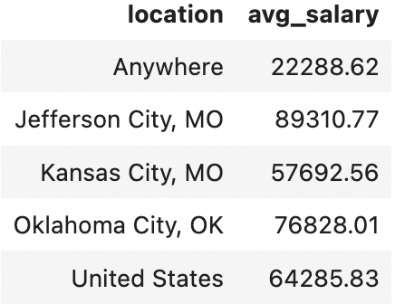
Mini Project 2
Intent: Analyze the salaries for data analyst jobs in the top 5 locations with the most job postings.
Output: The output of this query is a table that displays the location and the average salary range for data analyst job postings in each of the top 5 locations. This information can be useful for job seekers to get an idea of the average salary range for data analyst jobs in these locations, and for employers to determine competitive compensation packages for data analyst roles in these locations.
Key skills developed: SQL syntax for Common Table Expressions, joins, filtering, grouping and calculating averages.

Slide 8
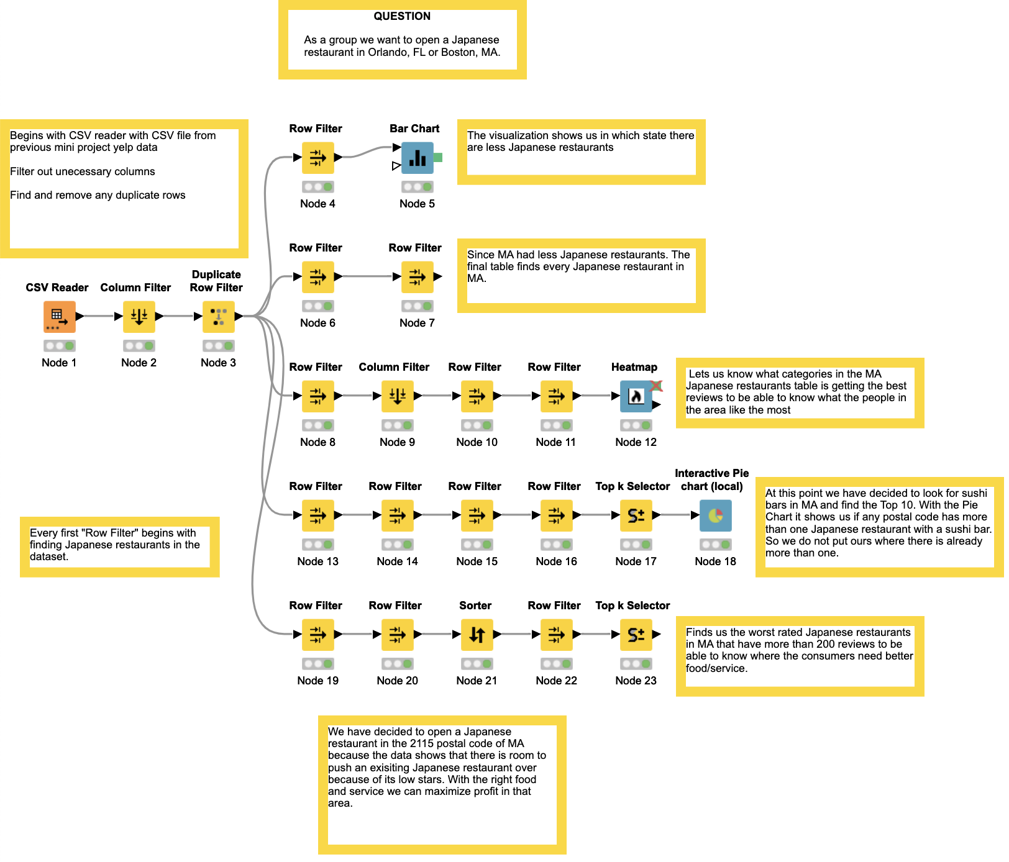
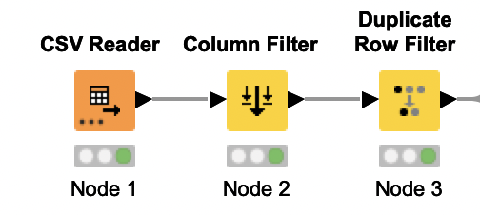
Mini Project 3
As a group we want to open a Japanese restaurant in Orlando, FL or Boston, MA
Part 1
CSV file from previous mini project yelp data
Filter out unnecessary columns
Find and remove any duplicate rows
Every first "Row Filter" begins with finding Japanese restaurants in the dataset.

Slide 9
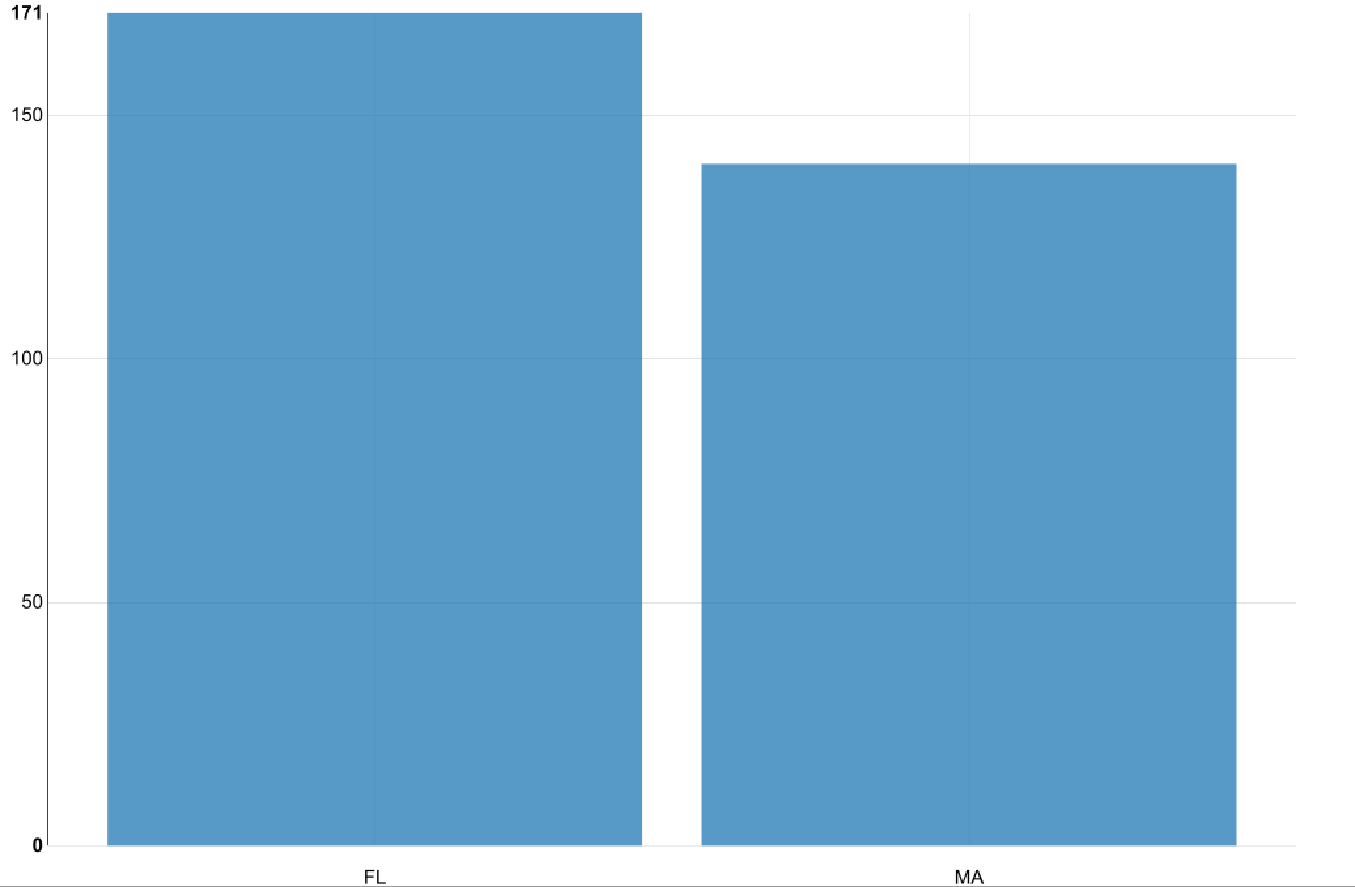
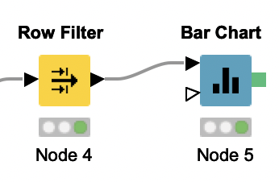
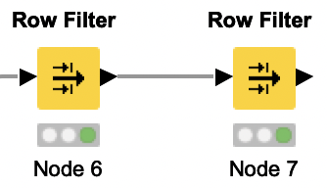
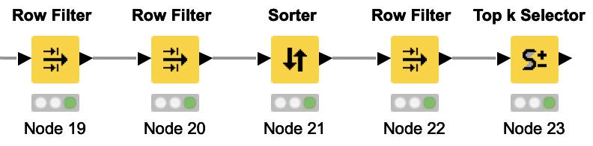
Mini Project 3
The visualization shows us in which state there are less Japanese restaurants
Since MA had less Japanese restaurants. The final table finds every Japanese restaurant in MA.
Finds us the worst rated Japanese restaurants in MA that have more than 200 reviews to be able to know where the consumers need better food/service.

Slide 10
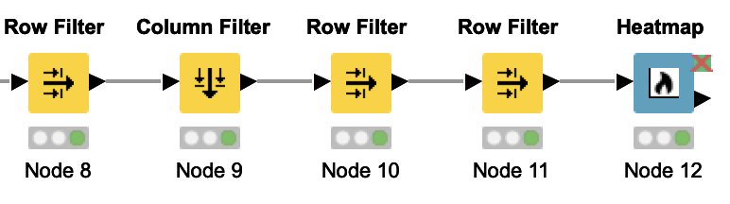
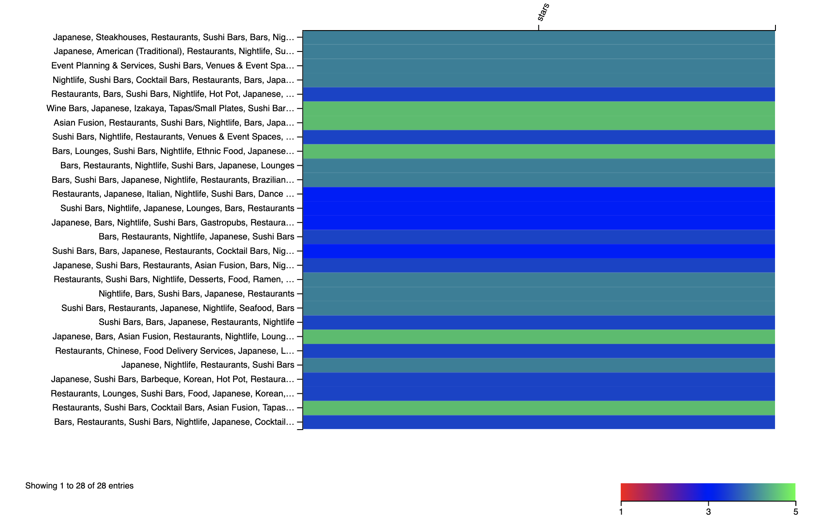
Mini Project 3
Lets us know what categories in the MA Japanese restaurants table is getting the best reviews to be able to know what the people in the area like the most

Slide 11
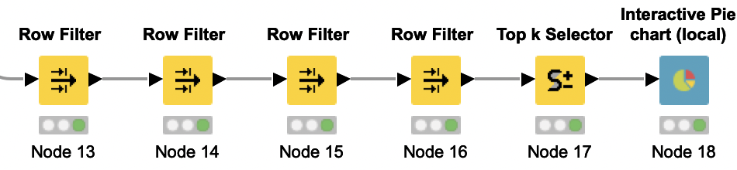
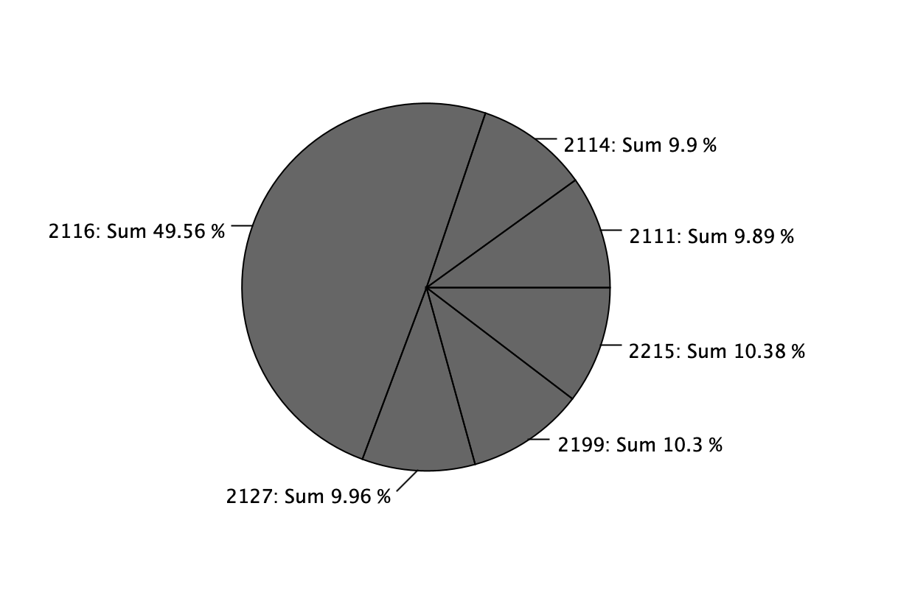
Mini Project 3
At this point we have decided to look for sushi bars in MA and find the Top 10. With the Pie Chart it shows us if any postal code has more than one Japanese restaurant with a sushi bar. So we do not put ours where there is already more than one.

Slide 12
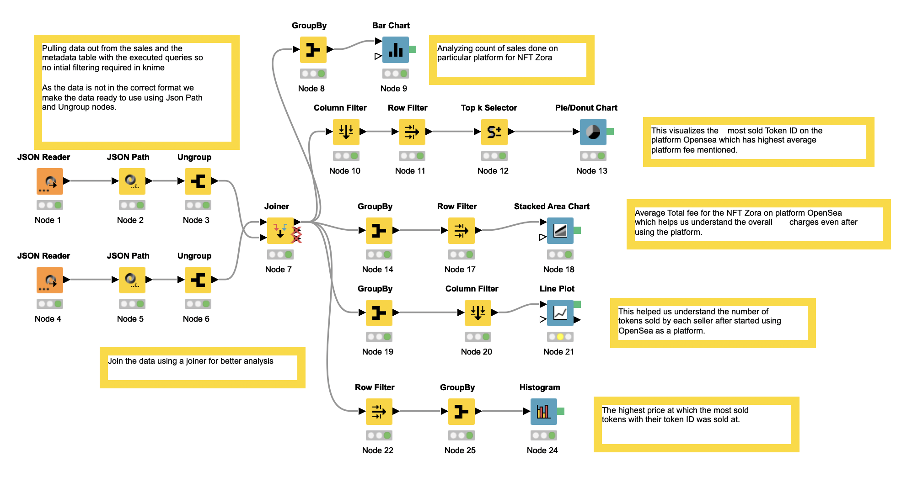
Part 2
Mini Project 3

Slide 13
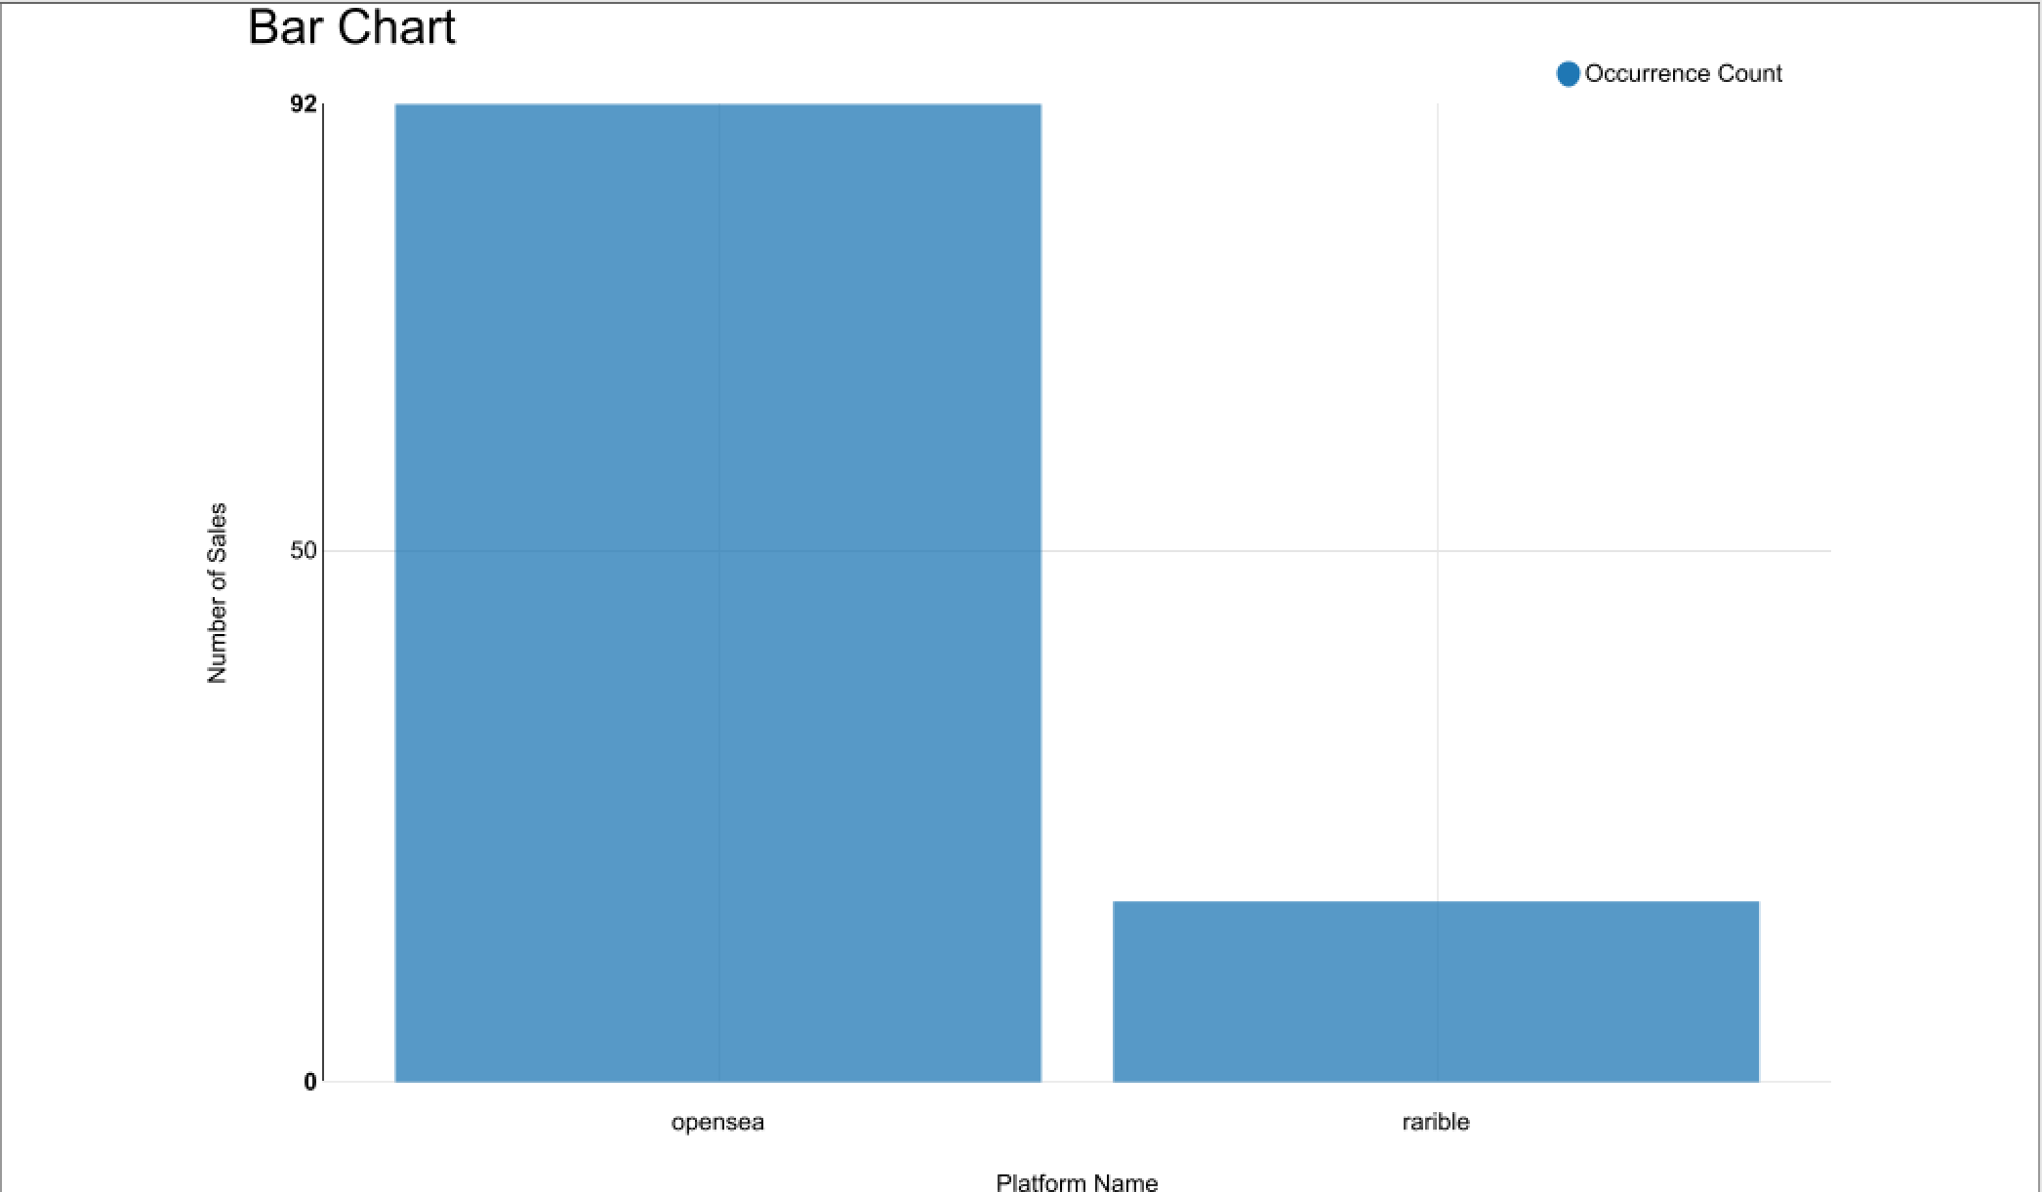

Mini Project 3

Slide 14
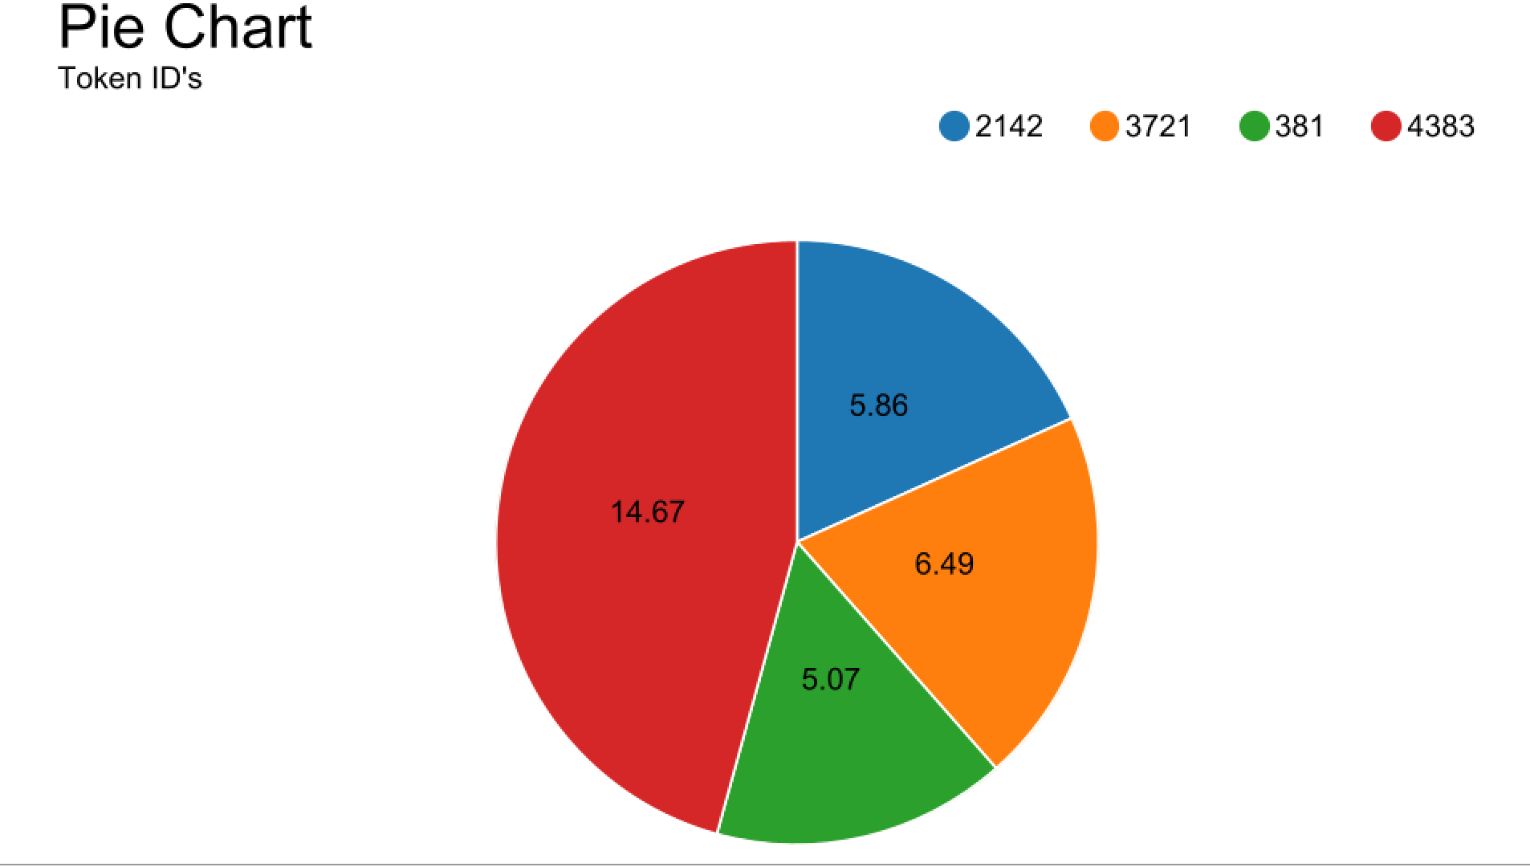



Mini Project 3

Slide 15
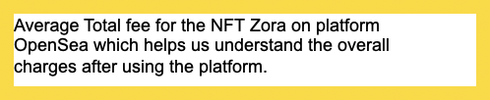
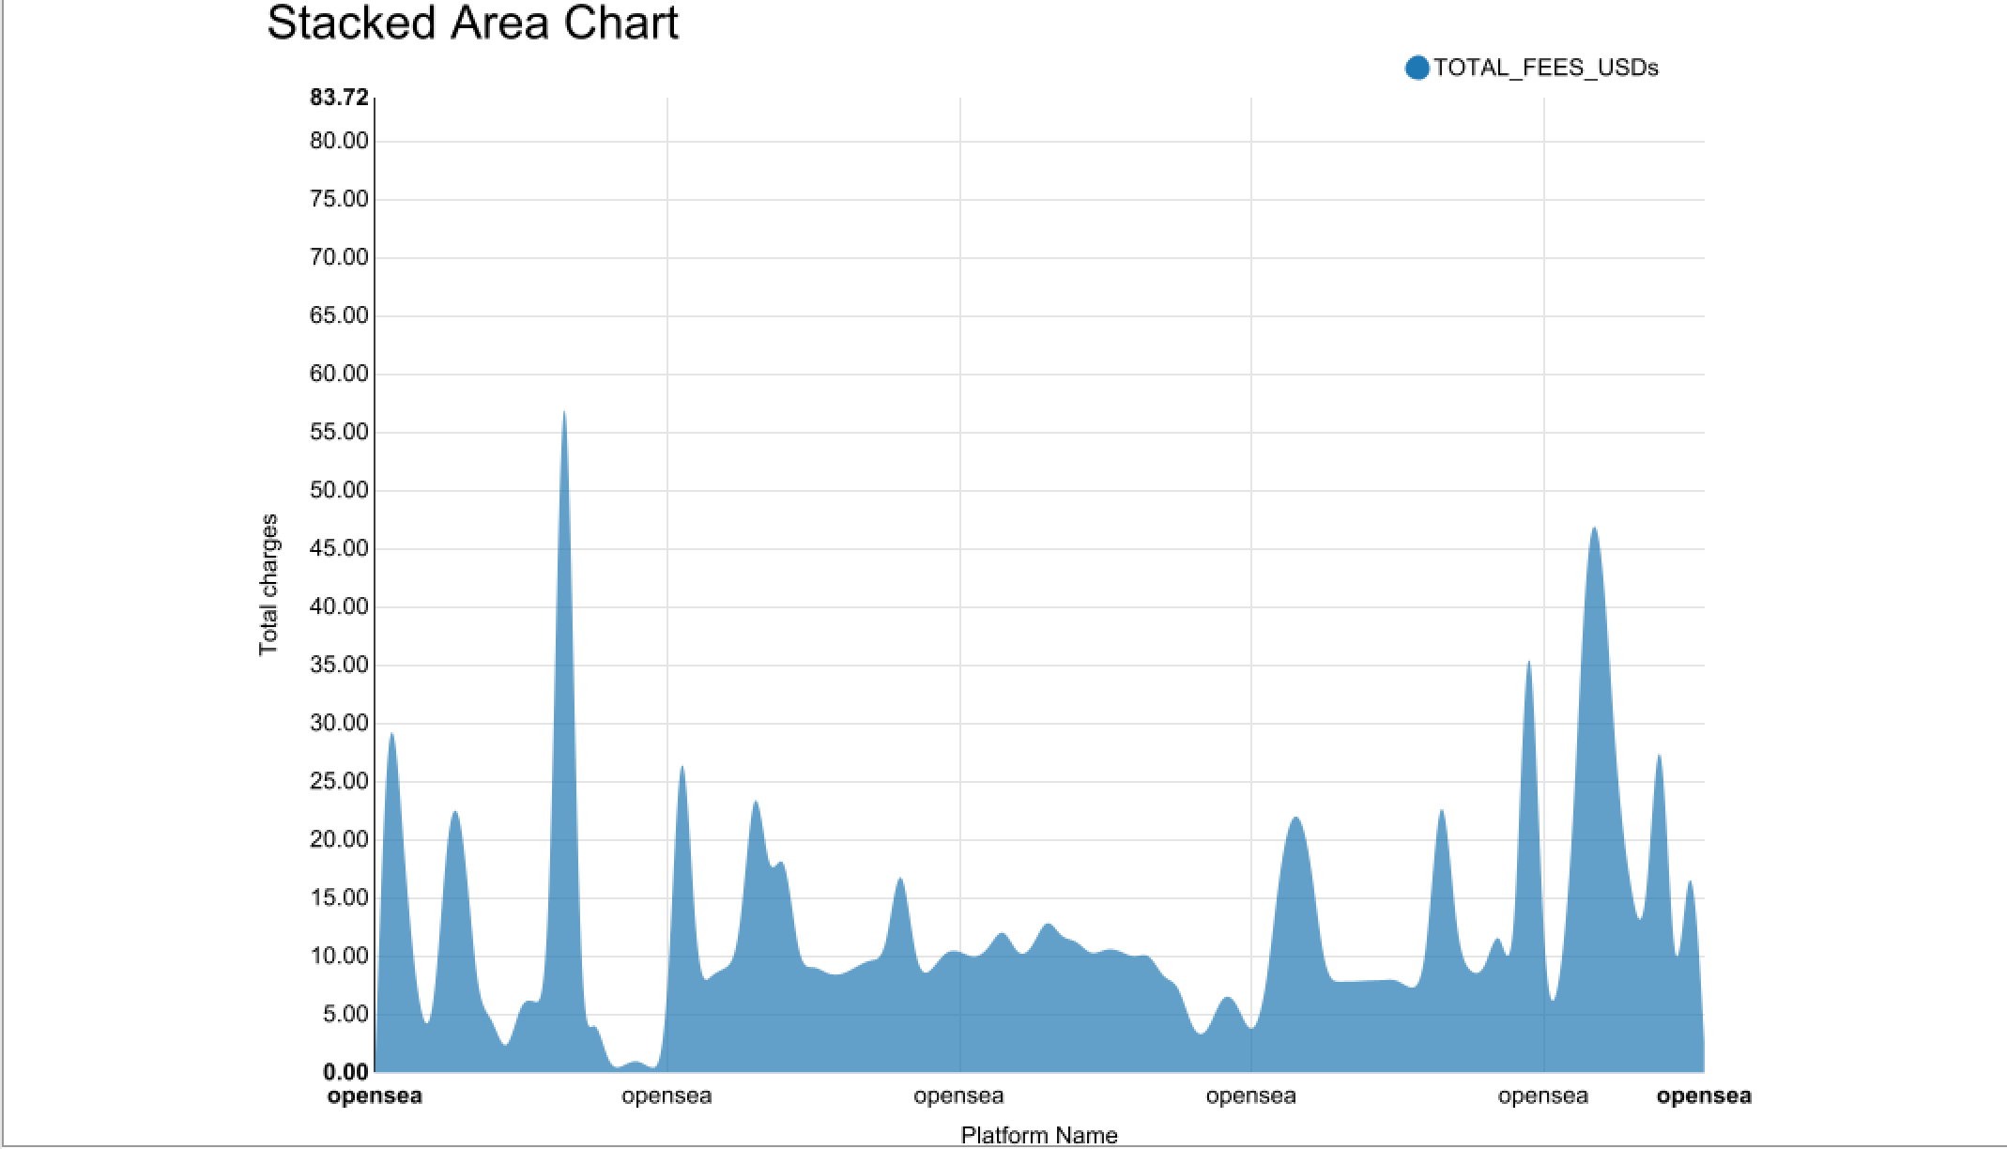
Mini Project 3

Slide 16
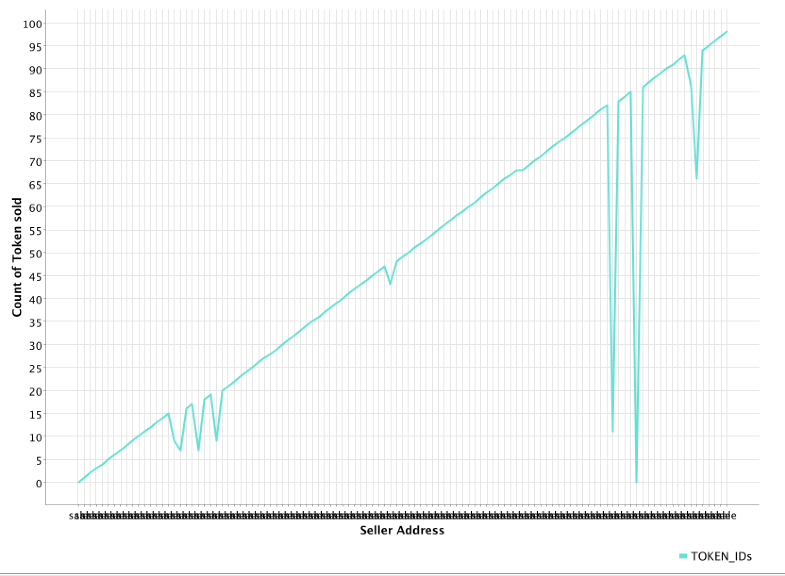
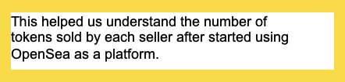
Mini Project 3

Slide 17
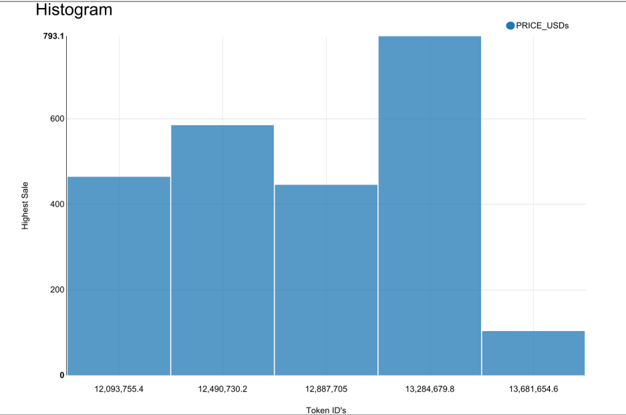
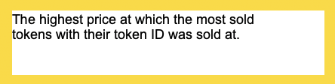
Mini Project 3

Slide 18
Mini Project 3
Conclusion
We have decided to open a Japanese restaurant in the 2115 postal code of MA because the data shows that there is room to push an existing Japanese restaurant over because of its low stars. With the right food and service we can maximize profit in that area.
Allowed us to understand how Open Sea platform boosted the sales of NFT Zora and how beneficial was it for people using the platform
Key Takeaways
This allowed us to experience other ways to filter through data that was not SQL
Built basic Knime skills to be able to further in our professional career
Challenging: One of the most difficult things was cleaning and preprocessing the data to ensure that it was accurate, complete, and in the right format.
Rewarding: Analyzing the data and finding insights that can help drive business decisions was the most rewarding part of the projects.

Slide 19
Thank you!

